Slide 1
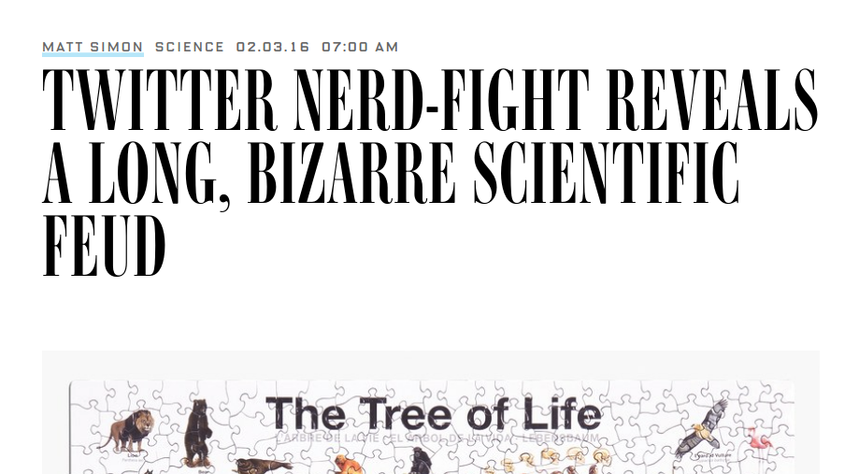
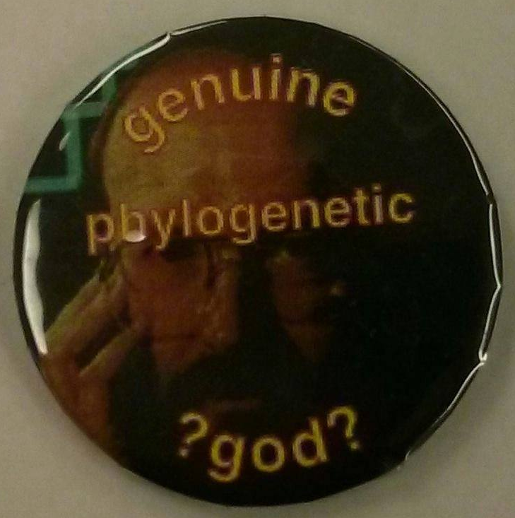
Conflict in science
#ParsimonyGate

Slide 2
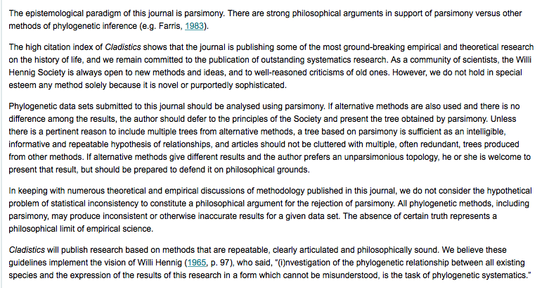

Slide 3
Parsimony still commonly used for:
Morphological analyses (though probabilistic models exist here too)
Starting trees
Understanding history of trait change

Slide 4
Practical considerations How do you find the most parsimonious tree?

Slide 5
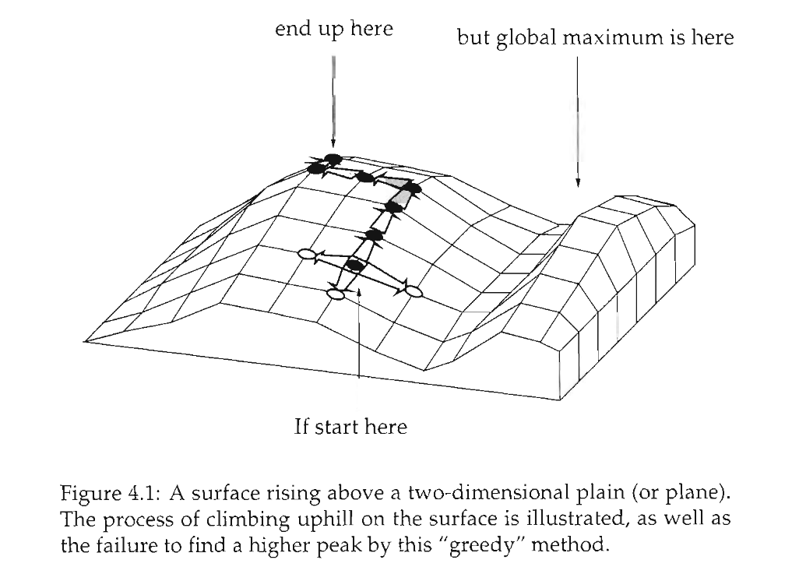
Heuristic searches

Slide 6
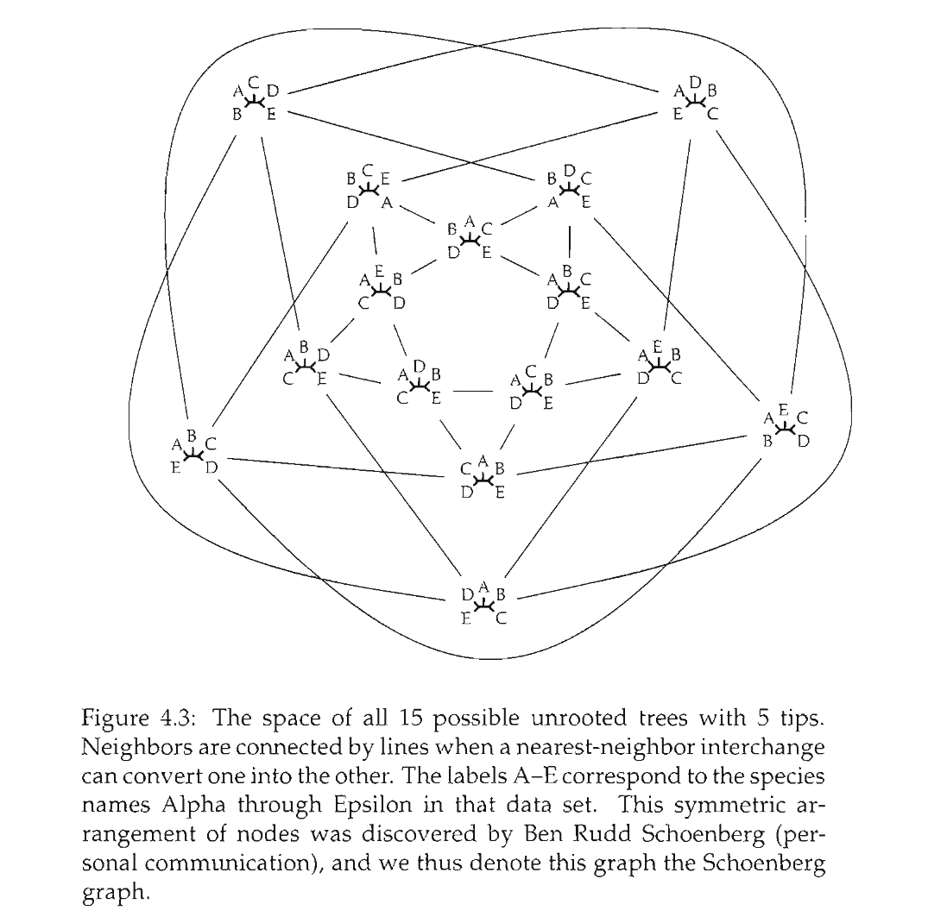

Slide 7
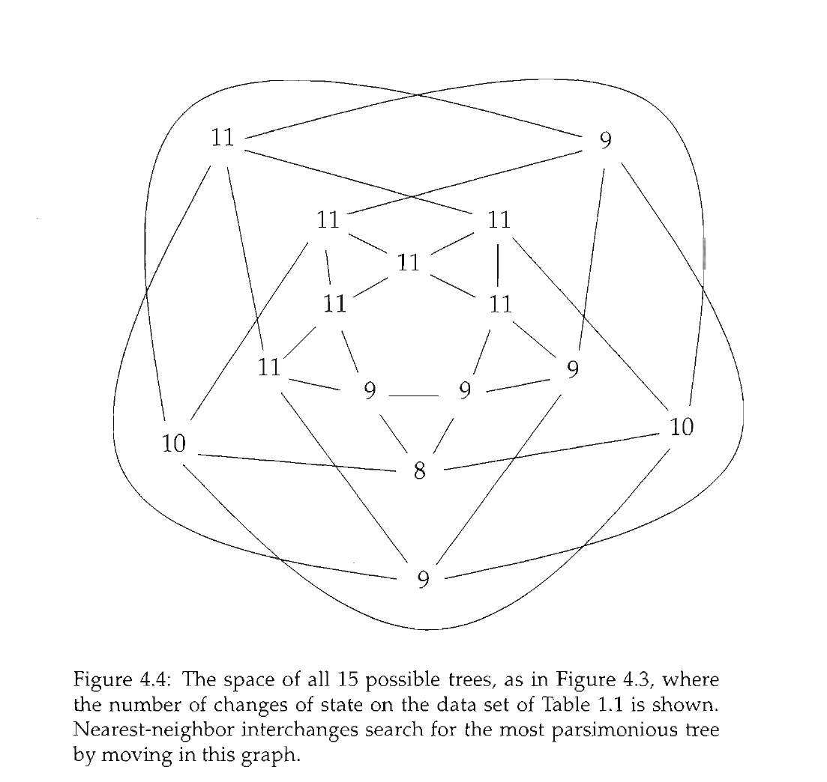

Slide 8
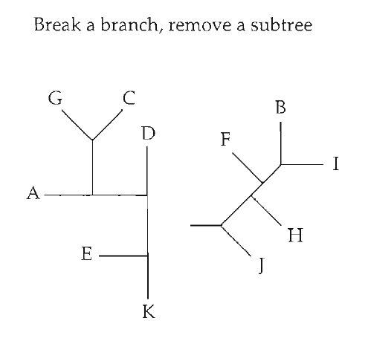
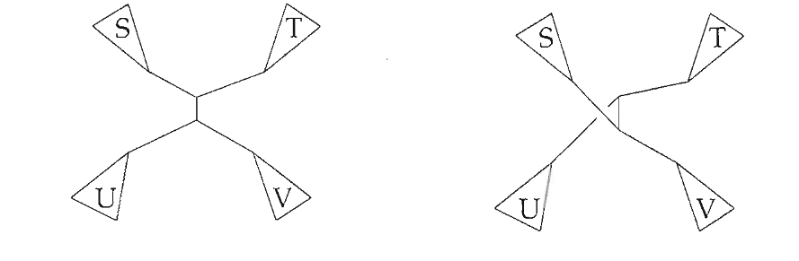
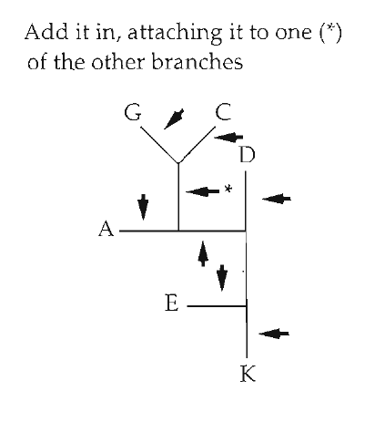
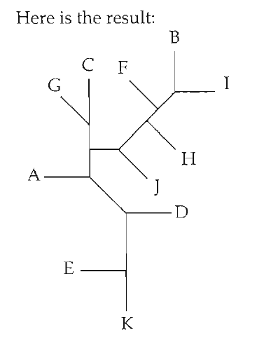
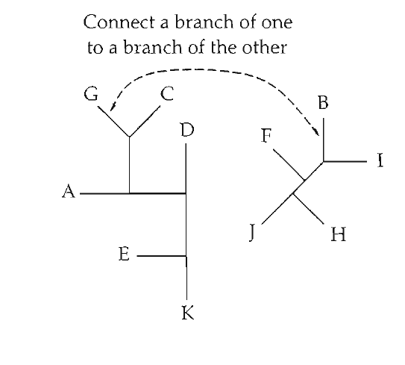
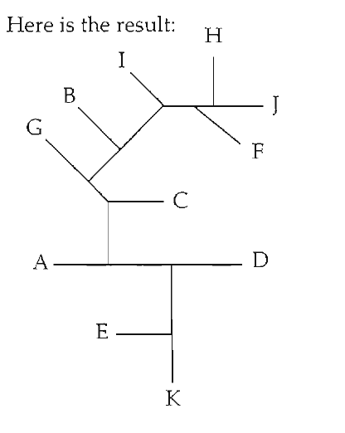
Tree space "moves"
Nearest Neighbor Interchange (NNI)
Tree bisection and reconnection (TBR)
Subtree pruning and regrafting (SPR)

Slide 9
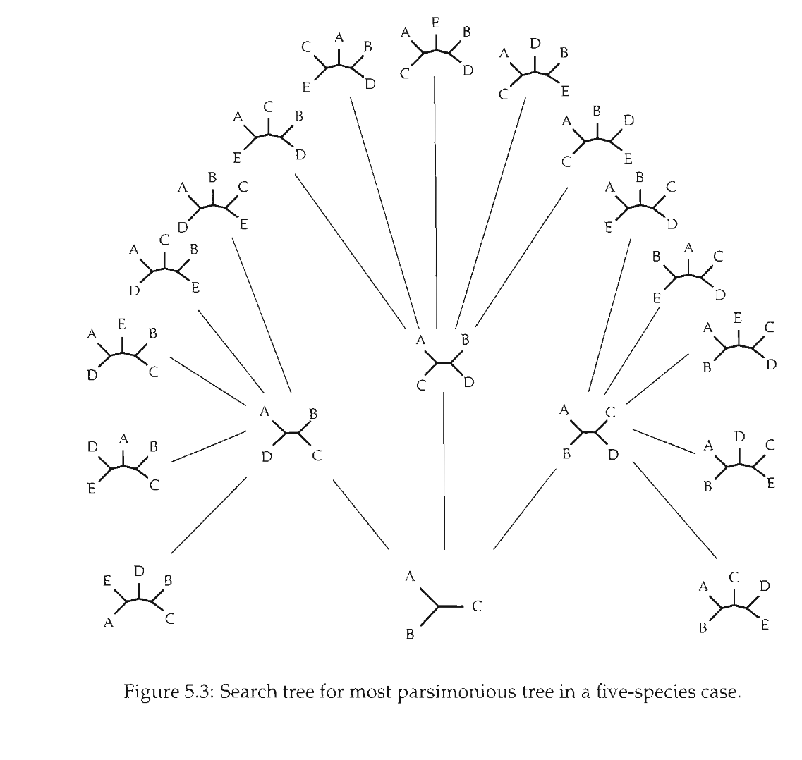
Branch and bound

Slide 10
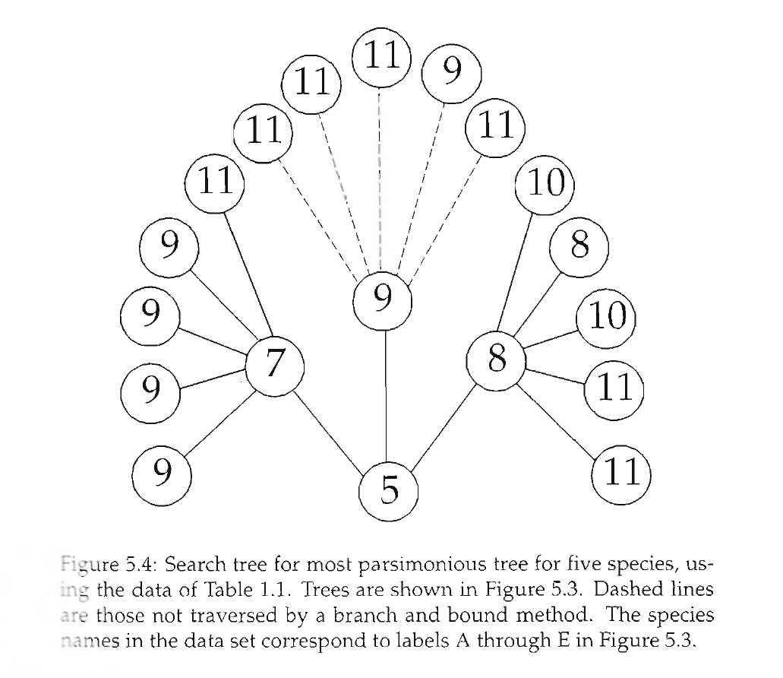
Branch and bound

Slide 11
Software: PAUP*, TNT, Mesquite, others...

Slide 12
Felsenstein & the birth of statistical phylogenetics

Slide 13
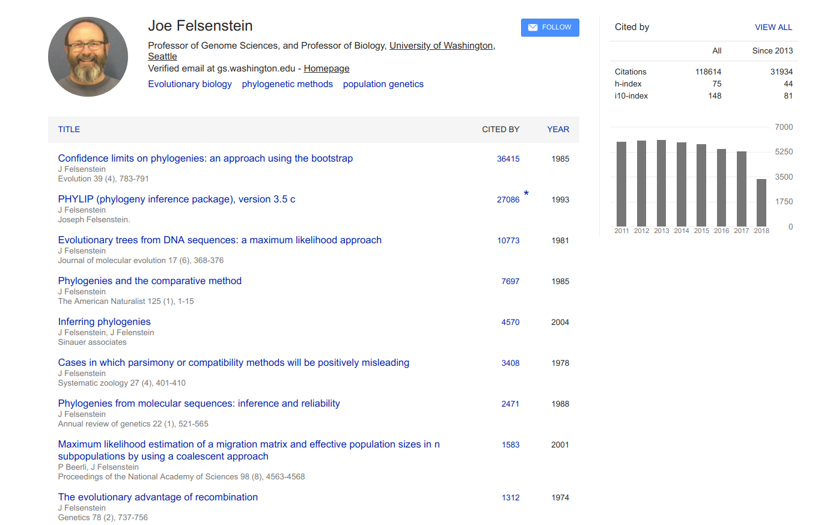

Slide 14
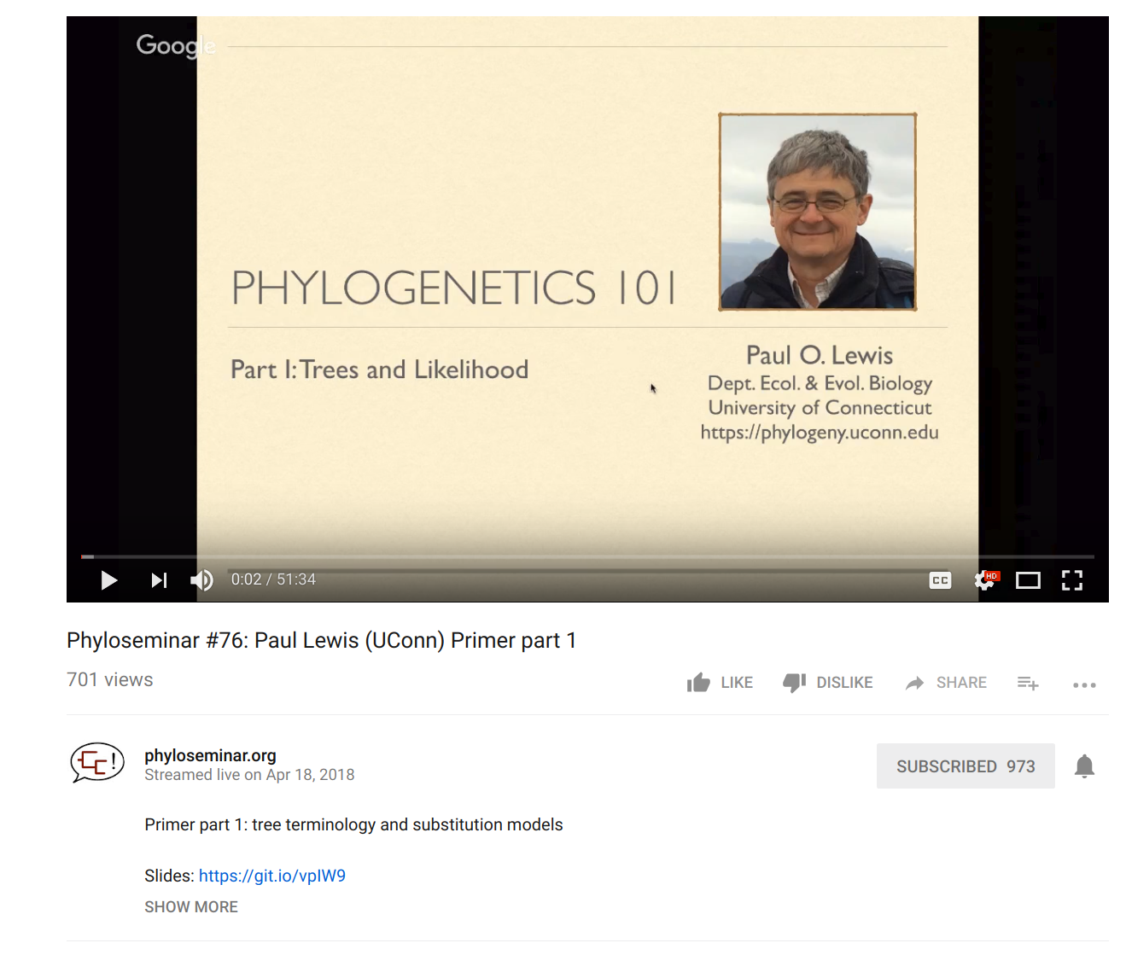
Full disclaimer: I'm borrowing some of this material from Paul Lewis (Uconn) (Check out his teaching materials!)

Slide 15
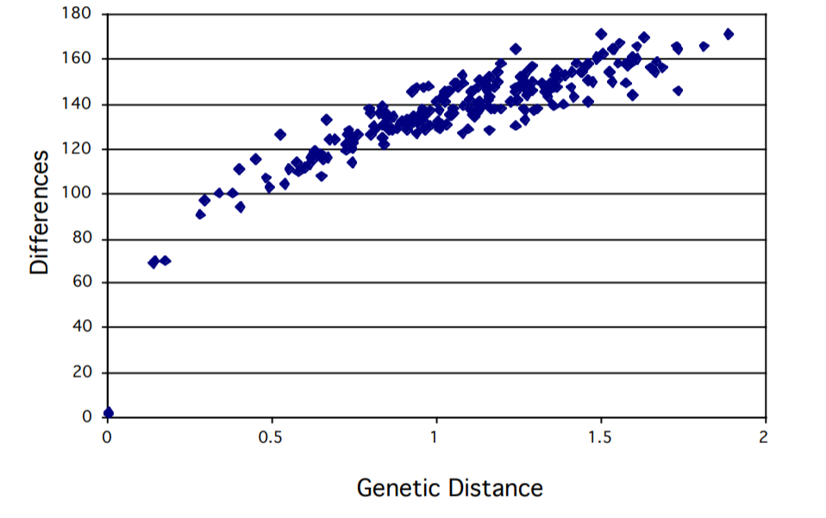
Why do we need statistics?

Slide 16
If two sequences are unrelated, what % of bases (aligned sites) do you expect to be identical?
A. 50%
B. 25%
C. 0%
D. I need more information

Slide 17
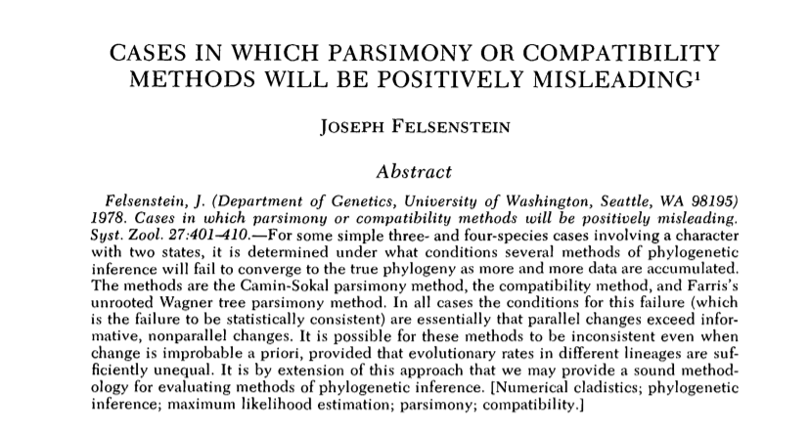
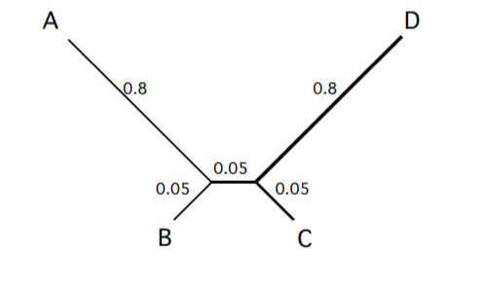
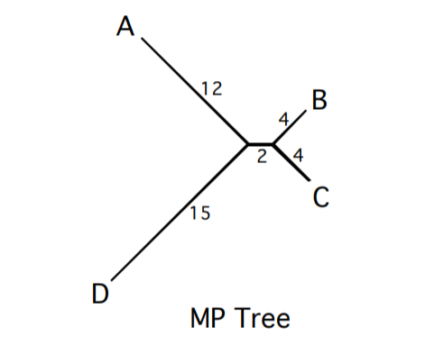
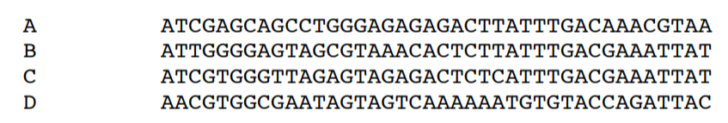
"Long-branch attraction"

Slide 18
P( | )
P( | )

Slide 19


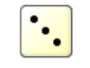
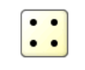
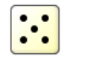
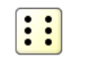
How do we treat trees probabilistically?
If these come up, change state
If these come up, stay the same

Slide 20
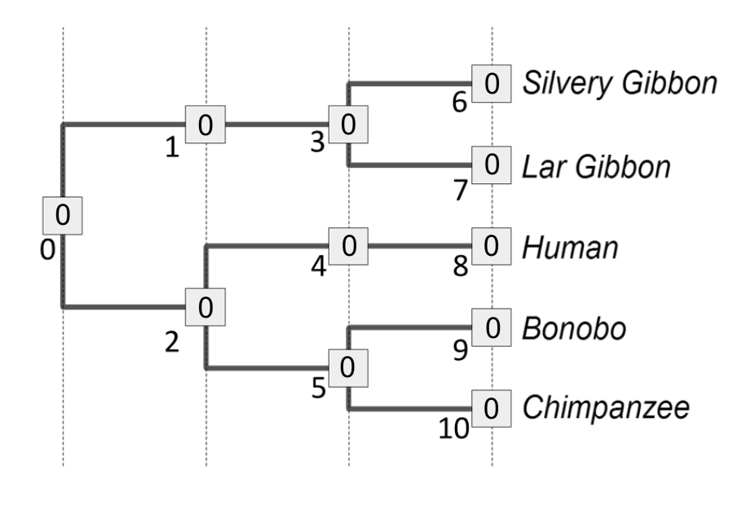

Slide 21
0

Slide 22
0
0

Slide 23
0
0
0

Slide 24
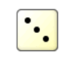
0
0
0
0
0

Slide 25
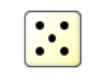
0
0
0
0
0
0

Slide 26
0
0
0
0
0
0
1

Slide 27

0
0
0
0
0
0
0
1

Slide 28

0
0
0
0
0
0
0
1
1
1

Slide 29
0
0
0
0
0
0
0
0
1
1
1

Slide 30
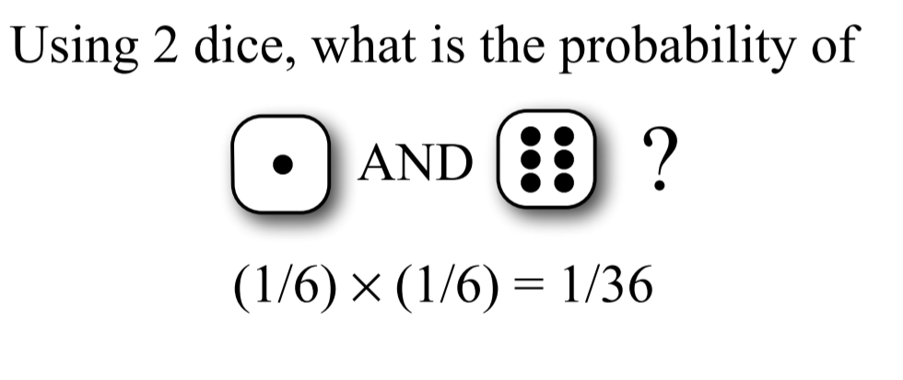
Combining probabilities: The AND rule
If two independent events occur, multiply their individual probabilities to get the full probability of an event

Slide 31
Combining probabilities: The AND rule in phylogenetics
0
0
0
0
0
0
0
0
1
1
1
Likelihood(D, N_{i}|T₁)* = (4/6)⁹ x (2/6)¹=0.0087

Slide 32
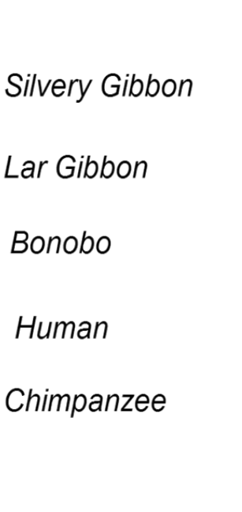
Combining probabilities: The AND rule in phylogenetics
0
0
0
0
0
0
1
0
0
0
1
Likelihood(D, N_{j}|T₂)* = (4/6)⁸ x (2/6)²=0.0043

Slide 33
0
0
0
1
1

Slide 34
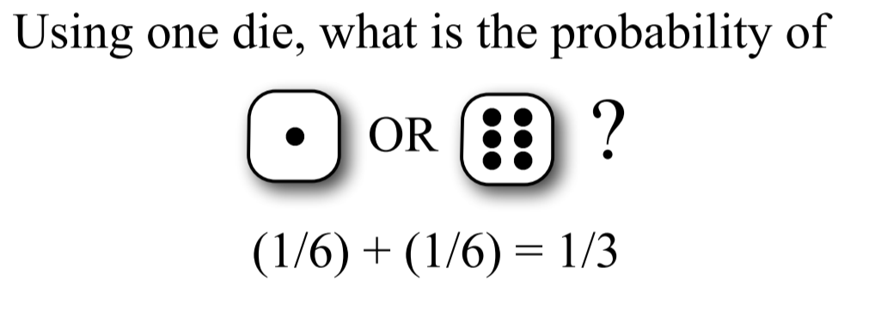
Combining probabilities: The OR rule
Two mutually exclusive probabilities should be ADDED together to get the total probability of the two events

Slide 35
Combining probabilities: The OR rule in phylogenetics
0
0
1
0
1
1
0
0
1
0
1
Likelihood (D, N_{k}|T₁) = (4/6)¹ x (2/6)⁹=0.000033

Slide 36
Combining probabilities: The OR rule in phylogenetics
0
1
1
0
1
0
0
1
1
1
1
Likelihood (D, N_{k}|T₁) = (4/6)⁷ x (2/6)³=0.00217

Slide 37
There are 2⁶ = 64 possible node assignments. We could calculate the likelihood of each one, then (?) them together, to get the total L(Data | Tree₁).
0
0
0
1
1

Slide 38
We used discrete time units. Biology will want continuous time

Slide 39
Continuous-Time Markov Models
Markov assumption = probability of change depends only on current state, not how long it has been in that state

Slide 40
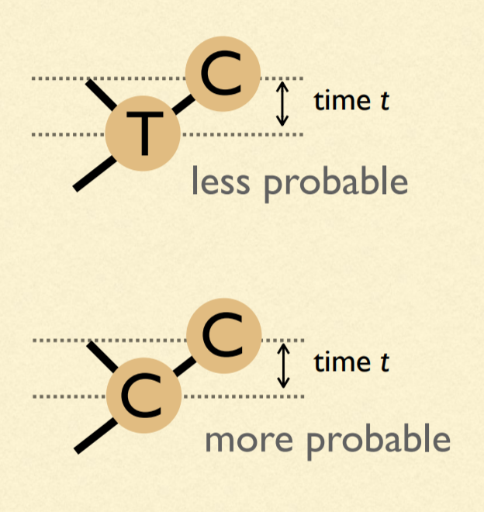
Our model of change depends on time: We must estimate branch lengths
Units of branch length will be expected number of substitutions per site
(= rate of substitions x time)

Slide 41
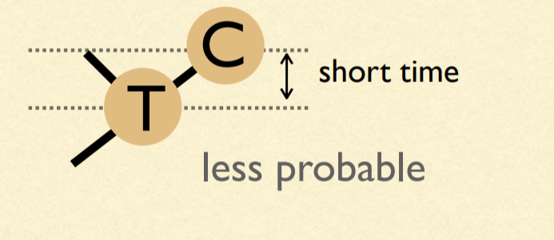
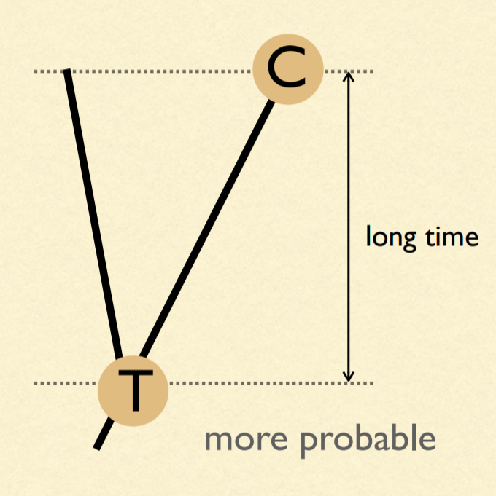
Probabilities are dependent on time

Slide 42
μ = 4β
A
β
β
β
β
A
T
G
C

Slide 43
A (very) simple phylogeny...
time
A
A
P_{AA} =
Probability nothing happened +
Probability something happened, but that the last thing that happened ended in an A

Slide 44
A (very) simple phylogeny...
time
A
A
P_{AA} = (e^{-μt} ) + (1 - e^{-μt})(1/4)
Probability something doesn't happen
Probability at least one thing happens
Probability that the last thing that happened ends in an A

Slide 45
A (very) simple phylogeny...
time
A
G
P_{AG} = (1 - e^{-μt})(1/4)
Probability at least one thing happens
Probability that the last thing that happened ends in an G

Slide 46
A (very) simple phylogeny...
time
A
C
P_{AC} = (1 - e^{-μt})(1/4)
Probability at least one thing happens
Probability that the last thing that happened ends in an C

Slide 47
A (very) simple phylogeny...
time
A
T
P_{AT} = (1 - e^{-μt})(1/4)
Probability at least one thing happens
Probability that the last thing that happened ends in an T

Slide 48
One last bit...substitutions vs. "events"
ν = (3/4)μt = 3βt
4ν/3 = μt
Only 3 out of 4 events results in a substitution. Thus, we can define the substitution rate ν.

Slide 49
P_{AA} = (e^{-μt} ) + (1 - e^{-μt})(1/4)
P_{AG} = (1 - e^{-μt})(1/4)
P_{AC} = (1 - e^{-μt})(1/4)
P_{AT} = (1 - e^{-μt})(1/4)

Slide 50
P_{AA} = (1/4) + (3/4)(e^{-4ν/3} )
P_{AG} = (1/4) - (1/4)(e^{-4ν/3})
P_{AC} = (1/4) - (1/4)(e^{-4ν/3})
P_{AT} = (1/4) - (1/4)(e^{-4ν/3})
Sanity check: Do they all add to 1?

Slide 51
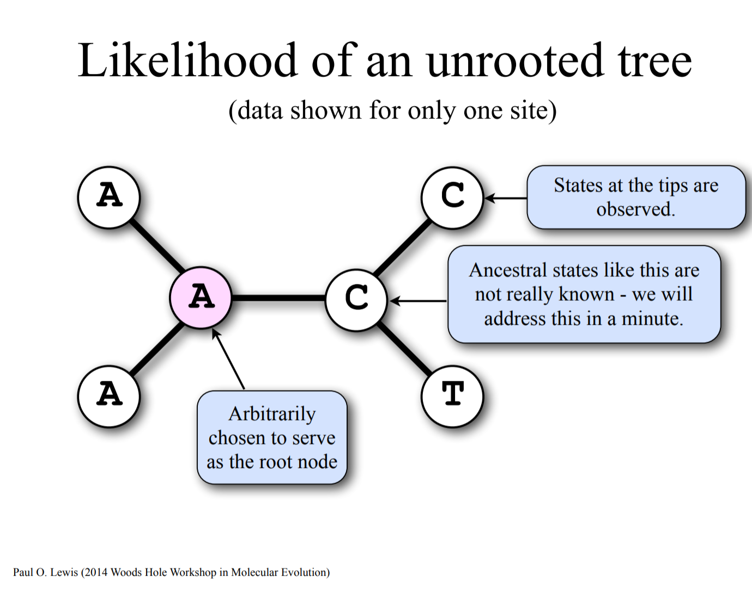

Slide 52
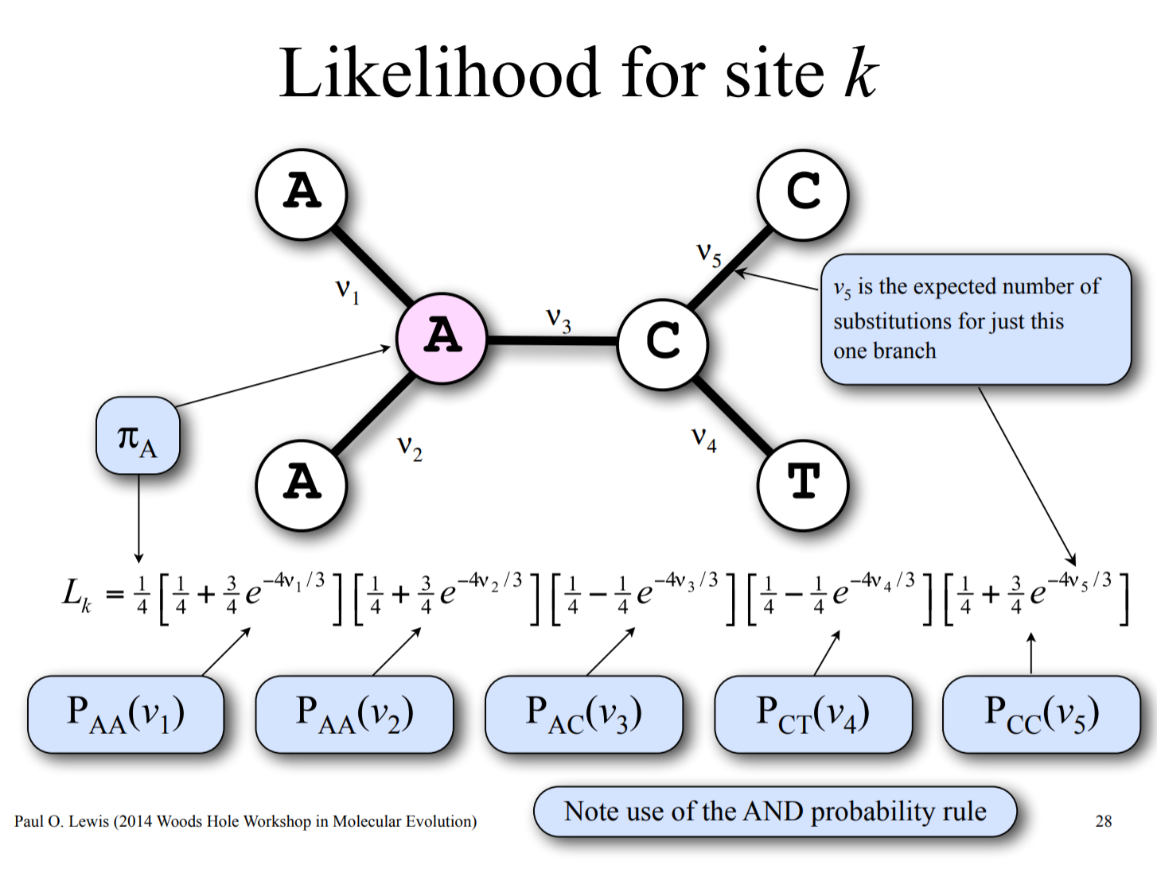

Slide 53
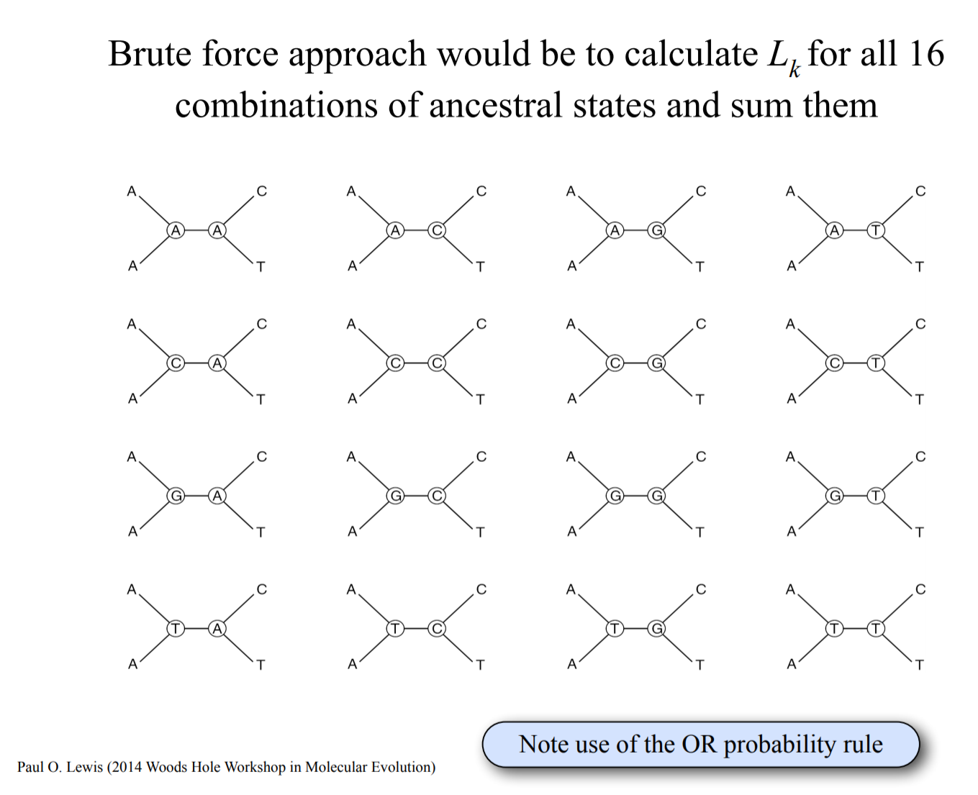

Slide 54
Pruning algorithm

Slide 55
Pruning algorithm

Slide 56
Pruning algorithm

Slide 57
Pruning algorithm

Slide 58
Pruning algorithm

Slide 59
Pruning algorithm

Slide 60
Pruning algorithm

Slide 61
Pruning algorithm

Slide 62
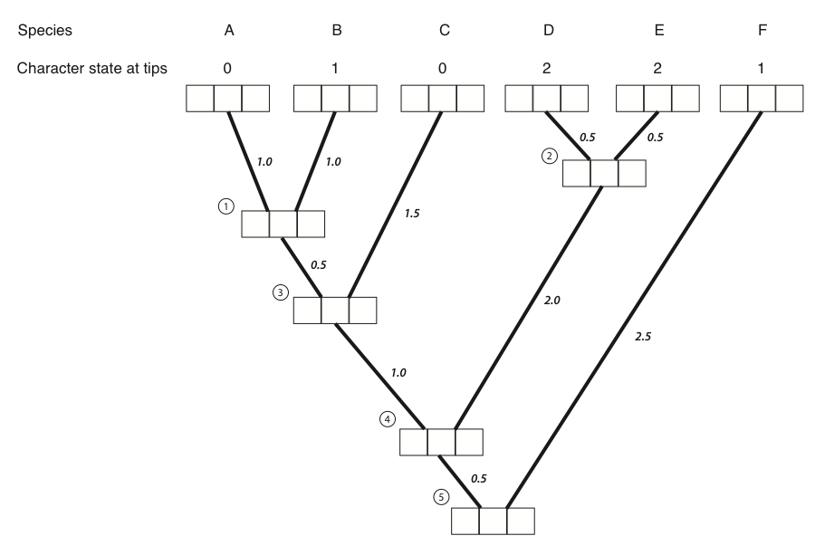
1 0 0
0 1 0
1 0 0
0 0 1
0 0 1
0 0 1

Slide 63
1 0 0
0 1 0
1 0 0
0 0 1
0 0 1
0 0 1
0.12 0.12 0.1

Slide 64
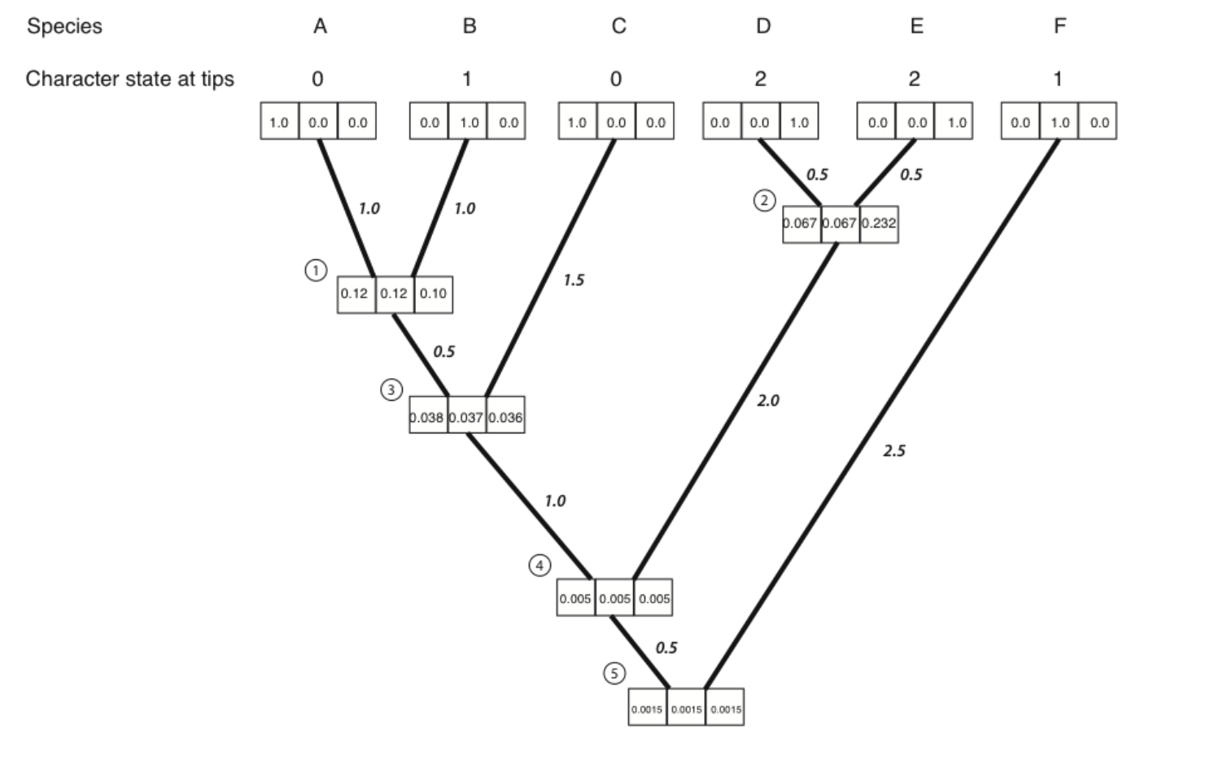

Slide 65
Jukes-Cantor Model (JC69)
Q matrix (instantaneous rates)
A C G T
A -3β β β β
C β -3β β β
G β β -3β β
T β β β -3β
Q =

Slide 66
Jukes-Cantor Model (JC69)
Transition probabilities:
P = e^{Qt}
Matrix exponentiation

Slide 67
JC69 is our most basic model. We will be able to do amazing things with generalizations of this one model!
A C G T
A - β β β
C β - β β
G β β - β
T β β β -
Q =

Slide 68
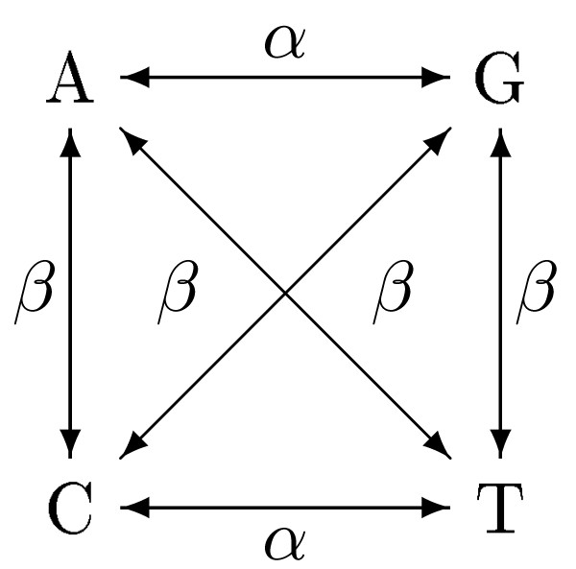
Kimura 2 Parameter model: K2P
A C G T
A - β α β
C β - β α
G α β - β
T β α β -
Q =

Slide 69
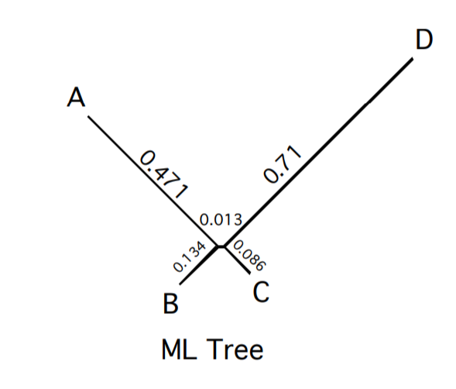
Returning to our original problem:
True Tree

Slide 70
Differences between statistical phylogenetics and parsimony
We get branch lengths in expected number of changes rather than minimum # of changes
We expect and probabilistically incorporate all possible paths to the data, not just the shortest path
We have the flexbility to modify and compare models
We have a straight-forward way to convert branch lengths to time (with fossils or other constraints)
We use ALL OF THE DATA, not just parsimony-informative sites

Slide 71
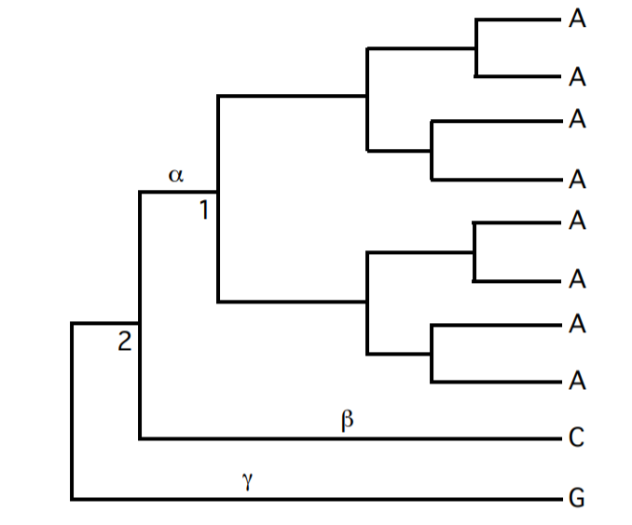
Example: Parsimony says node 2 can be either A, C, or G with equal number of steps.

Slide 72
Example: Likelihood will say that node 2 is most likely A. Why?

